Slide 1


MOTIVATIONAL INTERVIEWING
An introduction to Medical Personnel
Juliana M. Ramírez–Díaz
University of Pittsburgh
Applied Developmental Psychology MS. Program
Behavioral Management Project
April 27th, 2010
Notes:
Hello ladies and gentlemen. I am Juliana Ramirez, a graduate student in the School of Education at the University of Pittsburgh. The strategy I will present is Motivational Interviewing – An introduction to Medical Personnel.

Slide 2
OUTLINE PRESENTATION
Glossary
Introduction
Definition of Motivational Interviewing
Characteristics of Motivational Interviewing
Research that supports the strategy
Places, settings and situations you might use this intervention
Recommendations to health care professionals
Case Study
FAQs: Frequently Asked Questions
References
Notes:
Take a moment and look at the outline of this presentation. We will begin with an introduction to help you understand what Motivational Interviewing is. Then we will conclude with Frequently Asked Questions and references.

Slide 3
GLOSSARY
B.I.: Brief Interventions
M.I.: Motivational Interviewing
N.P.: Nurse Practitioner
Notes:
Before to start with the detailed presentation of this strategy, it is important to understand some of the terms we will use in this presentation.
I will refer to brief interventions as BI, motivational interviewing as MI and Nurse practitioner as NP.

Slide 4

INTRODUCTION
Pediatric Patients and nonadherence to treatments.
Uses for brief pediatric interventions.
Medical Personnel’s professional behavior.
Notes:
There are a variety of reasons why children do not adhere to treatment. The first one could be difficulty with the treatment regiment because of the child’s developmental level. Another one could be the lack of understanding by the parent as doubts of the benefits, perceived barriers to treatment, and demands of the treatment regiment.
MI is one form of these brief interventions that are used for prevention, early detection and brief treatment of behavioral and social problems associated with health care concerns.
Medical personnel who have received training in MI increase their understanding of their patients, and find it a beneficial strategy to incorporate into their daily practices.

Slide 5
MOTIVATIONAL INTERVIEWING…
  is one particularly efficacious form of Brief Interventions (BIs) used extensively with health risk behaviors. (Erickson, S.J., Gerstle, M., & Feldstein, S.W. 2005)
  implies the stages of change. Its goal is to help families to increase their motivation or readiness to change. (Gance-Cleveland, B. 2005).
is a strategy to facilitate compliance with treatment recommendations in pediatric clients and their families. It is a patient counseling technique that facilitates the interaction between the Nurse Practitioner and the patient to achieve positive behavior. (Gance-Cleveland, B. 2007).
is scientifically tested method of counseling clients and a useful intervention strategy in the treatment of lifestyle problems and desease. (Rubak, S., Sandbaek, A., Lauritzen, T., & Christensen, B. 2005).
Notes:
What is Motivational Interviewing?
There are different definitions by different authors.
Overall, it is a strategy to facilitate compliance with treatment recommendations in pediatric clients and their families. It is a patient counseling technique that facilitates the interaction between the medical personnel and the patient to achieve positive behavior.

Slide 6
CHARACTERISTICS OF
MOTIVATIONAL INTERVIEWING
Preparing for change
Patient-centered approach
Intrinsic Motivation to change
Feelings about change
Support of the patients
Requires the health care professional’s understanding
Notes:
I will describe some of the components within motivational interviewing.
1. First, MI focuses on how to prepare for necessary changes that help patients adhere to their prescribed treatment plan.
2. Second, It uses a patient-centered approach to address the ambivalence and discrepancies between a person’s current values, behaviors, and future goals.
3. Third, MI enhances a patient’s intrinsic motivators by exploring their perspective and reasons for ambivalence.
4. Forth, explores how a person feels about their interests, concerns, and guides the patient towards positive behavior choices.
5. Five, MI encourages the patient’s autonomy, collaboration, and the evocation of the patient’s ideas regarding change.
6. Six, MI requires health care professionals to understand their patient’s stage of change to target their intervention effectively.

Slide 7
CHARACTERISTICS continued
Accepting patient’s process of change
Interprets ambivalence in a positive manner
Role of the health care professional
Neutrality, empathy and resistance
Goals of Motivational Interviewing:
  Precontemplation
  Contemplation
  Preparation and action
  Maintence.
Notes:
7. Seven, MI includes accepting a patient where he or she is in the process of change.
8. Eight, MI interprets ambivalence as a resolvable issue that, once resolved, will move a person toward change.
9. Nine, MI incorporates reasonable and attainable treatment goals proposed by the client and clarified in collaboration with the health care professional.
10. Ten, MI conveys information to the client in a neutral and empathic manner while at the same time anticipating resistance as a normal response.
11.And finally, MI main goals are:
Precontemplation: To assist the family in working through its ambivalence about behavior change.
Contemplation: Assessing the importance of change, their confidence in making change, and readiness for change.
Preparation and action: Planning for change if they are ready.
And Maintence.

Slide 8
RESEARCH THAT SUPPORTS
Motivational Interviewing
Notes:
What does say the research about this strategy? Let’s see

Slide 9

Erikson, S.J., Gerstle, M., & Feldstein, S.W. (2005) Brief interventions and motivational interviewing with children, adolescents and their parents in pediatric health care settings.
Positive outcomes for the patient-centered communication
The benefits of developing rapport
Active participation of children in the doctor’s visit is related to satisfaction.
MI is effective in interventions to health-risk behaviors, development of adolescents identities, adaptive shift in illness, and increasing adherence.
Notes:
Erikson and colleagues in 2005 found that
The patient-centered communication has been associated with increased parent satisfaction, adherence to pediatric treatment recommendations, and disclosure of psychosocial problems.
Developing rapport with parents can yield beneficial results for the entire family, such as increasing family involvement in the prevention or treatment process.
Children who actively participate in the doctor’s visit demonstrate greater visit satisfaction and enhanced recall of prescribed regimens.

Slide 10

Gance-Cleveland, B. (2005). Motivational interviewing as a strategy to increase families' adherence to treatment regimens.
Knowledge or general advice vs. collaborative approach.
Motivational Interviewing has been shown to be effective in addictions as well nonaddictive health behaviors, and treatment adherence.
Notes:
Gance-Cleveland evaluated MI as a strategy to increase families adherence to treatment. They found
64% success rate with knowledge or general advice alone, and 85% success rate for the more collaborative approach that uses behavioral strategies.
MI has been shown to be beneficial in controlling alcohol and drug addictions, and nonaddictive health behaviors, as well as decreasing high-risk behaviors in HIV clients.
They found that MI increased treatment compliance in diabetics, medication regimens, pain treatment, and eating disorders.

Slide 11

Rubak, S., Sandbaek, A., Lauritzen, T., & Christensen, B. (2005). Motivational interviewing: a systematic review and meta-analysis.
Motivational interviewing could be effective with just 15 minutes.
Its effectiveness did not depend upon the counselor’s profession.
Notes:
Motivational interviewing was effective even in brief encounters of only 15 minutes, with a likelihood of increasing its effectiveness with more than one patient encounter, and with no adverse effects reported.
Health care providers who acted as counselors were psychologist in 55% of the studies, medical doctors in 30%, and other medical personnel such as nurses, midwives, and dieticians in 15%.

Slide 12
Rubak, S., Sandbaek, A., Lauritzen, T., Borch-Johnsen, K., & Christensen, B. (2006). An education and training course in motivational interviewing influence: GPs' professional behavior--ADDITION Denmark.
After Medical personnel took a course on Motivational Interviewing
they:
wanted to implement changes for their daily practice
found it to be highly effective
consider positive aspects for the time implied for MI
saw improvements in their patient-doctor relationship.
Notes:
Rubak and colleagues in 2006 found that after a course in MI:
The medical personnel seemed to change their professional behavior in daily practice.
Medical personnel found MI to be more effective than traditional advice.
Medical personnel reported that the use of the new technique was no more time-consuming than traditional advice.
And expressed that MI improved the patient-doctor relationship.

Slide 13

PLACES, SETTINGS AND SITUATIONS YOU MIGHT USE THIS INTERVETION
Parents of younger adolescents
Children and adolescents: chronic illness compliance and developing identities and independence
Other delivery formats: interactive computer programs, self-help materials, and group sessions.
Notes:
There are different scenarios in where MI could be use.
To improve parental behaviors.
With adolescents’ competing demands of identity development and desire to assert independence.
To increase compliance with children and adolescents with chronic illness.
And into other delivery formats, including interactive computer programs, self-help materials, and group sessions.

Slide 14
RECOMMENDATIONS TO HEALTH CARE PROFESSIONALS
Principles of Motivational Interviewing:
  Genuine expression of empathy
  Reflective listening
  Development of discrepancy
  Rolling with the client’s resistance
  Supporting patient’s self-efficacy
Notes:
To apply correctly MI, it is important to take in mind these recommendations:
One, Using open-ended questions to encourage the patient to think though and provide richer, fuller responses.
Two, The health care demonstrates reflective listening to reasoning with a patient and to clarifying the meaning of their statements.
3. Three, Development of discrepancy between the patient’s current behavior and the treatment goal.
4. Four, Use affirmations to demonstrate support of a patient’s efforts.
5. And five, use of summary statements which include integrating the full picture of the pros and cons of a patient’s behavior, followed by checking in with patients to make sure they feel you fully understand their situation.

Slide 15
RECOMMENDATIONS continued
Use of developmental framework:
Understand children ‘s reasoning and their environmental context
Concrete and focused behavioral recommendations
Include adults to support the intervention with adolescents
Notes:
Use the developmental framework to have outcomes related to modify health-related behavior:
1. First, Understand children’s causal reasoning, language ability, and self-understanding, as well as their environmental context.
2. Second, Be concrete and focus on behavioral recommendations for the child.
3. And third, The intervention should support in company of the adult

Slide 16
RECOMMENDATIONS continued
Use the family-centered approach:
Focused on the family’s beliefs, values, and health behaviors.
Enhance the family’s self efficacy and life skills
How to motivate parents and children to change behavior:
Establishing relationship
Setting agenda
Assessing importance, confidence, and readiness
Exploring the importance of making behavior change
Building confidence in the ability to change
Planning for change
Notes:
Working with families using the family-centered approach:
The Heath care professionals will be more effective in improving treatment compliance with an emphasis on empowering the parent, and focusing on the family’s beliefs, values, health behaviors, and life skills.
The parents and children can be motivated by:
Establishing relationship
Setting an agenda
Assessing importance, confidence, and readiness
Brainstorming about the extreme consequences of changing and not changing the behavior at hand
Building confidence in the ability to change
Planning for change.

Slide 17
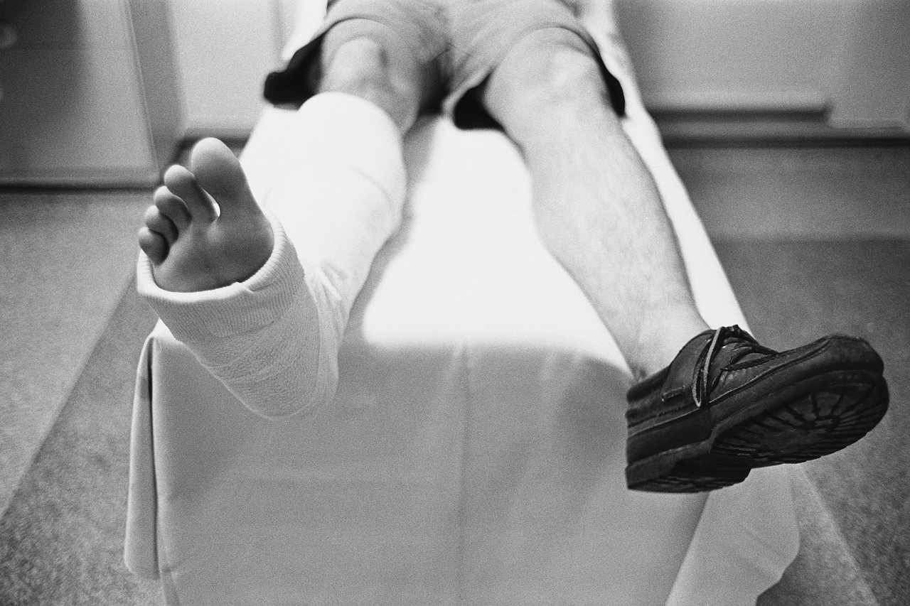
Meet Rodrigo
Notes:
Now we are going to see how the Motivational Interviewing concepts could be applied to a case study. Lets meet Rodrigo.

Slide 18
CASE STUDY
Rodrigo is 12 years old. He broke his leg in multiple places in a bad fall during an earthquake. Rodrigo has had his cast removed but now needs to comply with physical rehabilitation to encourage muscle development. After 3 weeks of prescribed home exercises, Rodrigo’s leg muscles are not regaining strength or flexibility. With both his parents working, Rodrigo sometimes spends the night with his grandmother and cousins. Because of the distance to the physical therapist, he has missed several appointments. The doctor is frustrated and worried. Rodrigo is showing signs of depression.
Notes:
Read carefully the description

Slide 19
CASE STUDY REVISITED
Rodrigo's doctor uses the principles of Motivational Interviewing to support Rodrigo's rehabilitation. The doctor utilized a family-centered approach and identify their values, beliefs, and health behaviors. The doctor expressed empathy and asked open-ended questions to Rodrigo and his family to help identify the discrepancy between Rodrigo's current behavior and his treatment goal. After reflective listening, the doctor was able to
determine a few barriers to Rodrigo's treatment compliance. His parents expressed that busy jobs mean less time to help him with the home therapies. His physical therapy appointments are scheduled during the day when they cannot drive him. The doctor helps them explore the pros and cons of the treatment recommendations. He also helps them forecast the long-term physical consequences for Rodrigo if he is unable to adhere to treatment.
Notes:
Now lets see the case with the MI concepts applied by Rodrigo’s Doctor.

Slide 20
Case study revisited continued
After considering the goals and values for Rodrigo's rehabilitation, his parents suggest the inclusion of his grandmother in planning because the
child and his grandmother spend some nights together. She can help Rodrigo with his home treatment while they are working. The doctor, Rodrigo, his parents, and his grandmother established a plan to work together. They set an agenda based on their schedules, each one recognizing their life skills. They auto-assign activities in order to reach the main goal for Rodrigo's rehabilitation. Rodrigo's health grew stronger as signs of depression decreased while he regained his muscle strength and flexibility. The entire family's self-image, self-efficacy, and self-concept were improved because of the doctor's use of Motivational Interviewing.

Slide 21
Frequently Asked Questions
Q. Does one need a certificate to use Motivational Interviewing?
Q. Can teachers use MI when helping students think about noncompliance and behaviors?
Notes:
Some frequently asked questions could be:
First,
Does one need a certificate to use Motivational Interviewing?
R. You do not need a certificate to use motivational interviewing. You just need to know the principles and the main concepts to apply them in the case you consider it will be helpful to get the outcomes you are looking for.
And second,
Can teachers use MI when helping students think about noncompliance and behaviors?
R. Yes. Teachers can use MI to help students to think how their behavior s is affecting their goals and how they can improve their roles in their own challenges.

Slide 22
REFERENCES
Erickson, S. J., Gerstle, M., & Feldstein, S. W. (2005). Brief interventions and motivational interviewing with children, adolescents, and their parents in pediatric health care settings: a review. Archives of Pediatrics & Adolescent Medicine, 159(12), 1173-1180.
Gance-Cleveland, B. (2005). Motivational interviewing as a strategy to increase families' adherence to treatment regimens. Journal for Specialist Pediatric Nursing, 10(3), 151-155.
Notes:
More details about this topic can be found on the references used for this presentation.

Slide 23
Gance-Cleveland, B. (2007). Motivational interviewing: improving patient education. Journal of Pediatric Health Care, 21(2), 81-88.
Rubak, S., Sandbaek, A., Lauritzen, T., & Christensen, B. (2005). Motivational interviewing: a systematic review and meta-analysis. British Journal of General Practice, 55(513), 305-312.
Rubak, S., Sandbaek, A., Lauritzen, T., Borch-Johnsen, K., & Christensen, B. (2006). An education and training course in motivational interviewing influence: GPs' professional behavior--ADDITION Denmark. British Journal of General Practice, 56(527), 429-436.

Slide 24
Thank you!
Gracias!
Copyright 2010 J.M. Ramírez-Díaz
Please contact the author at jumaradi@gmail.com if you wish to duplicate this material.
Notes:
Thank you so much!

